Slide 1







Enterprise Blockchain Developers (Intermediate)
In support of
Powered By

Slide 2
Outline
Code Demo
Web3 Intro
Web3 React Interaction
© 2017-2020 SmartMesh Foundation Pte. Ltd. | MeshBox Foundation Pte. Ltd.

Slide 3
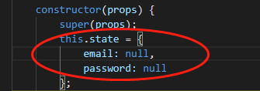

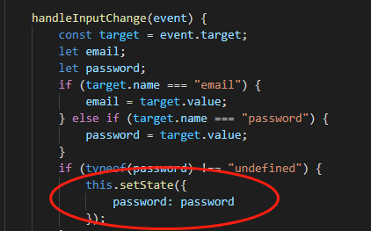
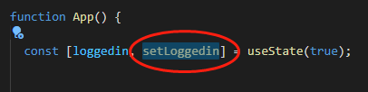
Functional Component vs Class Component
1 State
2 setState

Slide 4
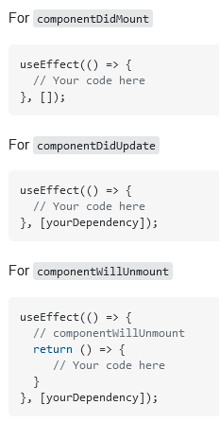
Functional Component vs Class Component
3 componentDidMount vs useEffect
2 Context (covered)

Slide 5
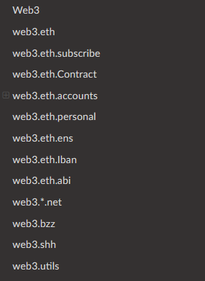
Web3 Introduction
Components: https://web3js.readthedocs.io/en/v1.3.0/
eth - package allows you to interact with an Ethereum
blockchain and Ethereum smart contracts. query, sendTx etc.
subscribe - function lets you subscribe to specific
events in the blockchain. Example: Dex trading
contract - makes it easy to interact with smart contracts
on the ethereum blockchain
account - contains functions to generate Ethereum
accounts and sign transactions and data.
personal - package allows you to interact with the
Ethereum node’s accounts

Slide 6
Gas vs GasLimit vs GasPrice Nonce
Gas vs GasPrice vs Gas Limit
Gas is the unit of calculation that indicates the fee for a particular action or transaction.
Excuting every line of code requires gas = fule
The Gas Limit is the maximum amount of Gas that a user is willing to pay for performing this action or confirming a transaction (a minimum of 21,000).
Max Gas
The price of Gas (Gas Price) is the amount of Gwei that the user is willing to spend on each unit of Gas.
Auction = willingness to pay
What is Nonce

Slide 7

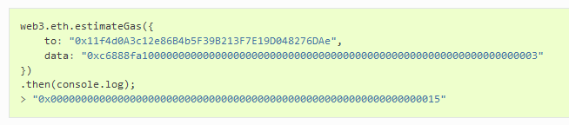
Estimate Gas
Generate Encode Data
Get Estimated Gas

Slide 8

Transaction Type
Query vs Write
Call - query, no gas
Write to Contrcts
Step 1: Generate Encode Data

Slide 9
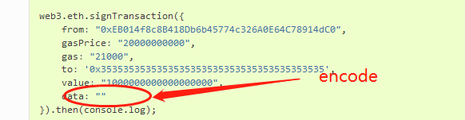

Transaction Type
Query vs Write （Code Demo)
Write to Contrcts
Step 2: Sign a transaction
Step3: Send Raw Transaction
replace 0x with signedTransaction.rawTransaction

Slide 10
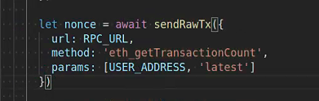
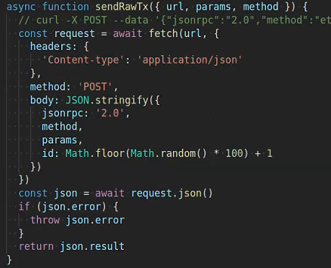
Function Call RPC vs signedTx
RPC （Code Demo)
Send Raw Post request

Slide 11
Code Demo
Add Web3 to React (Code Demo)

Slide 12
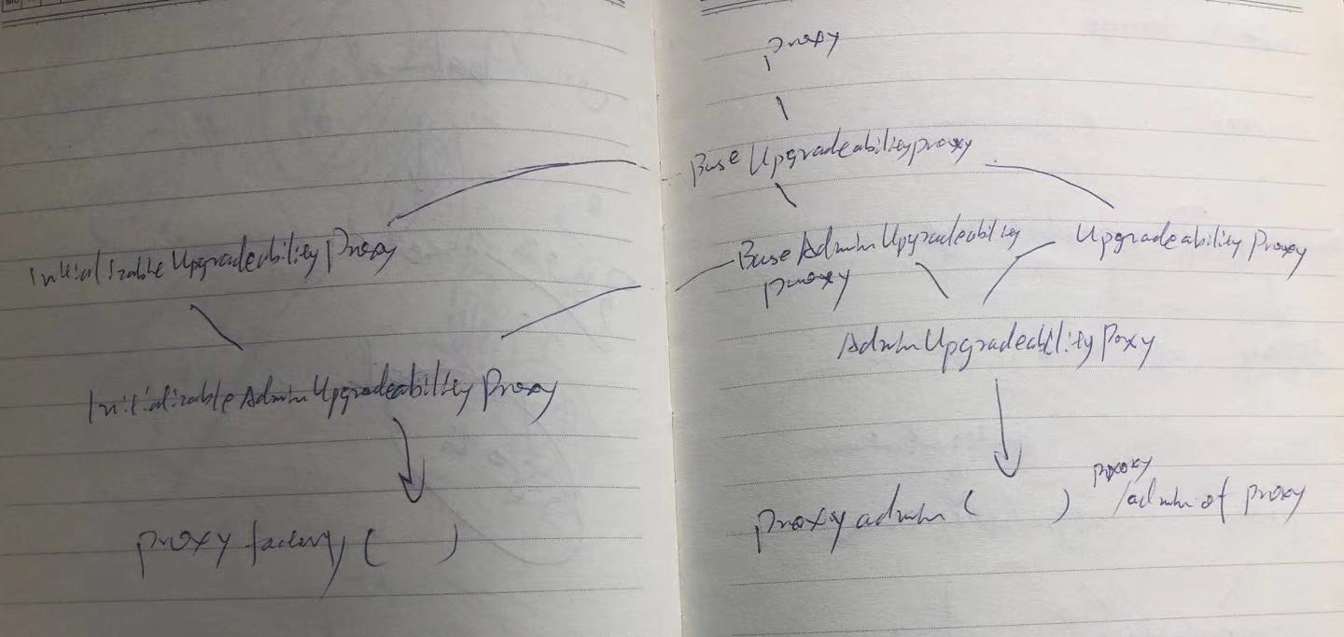
Dive into Proxy (Architect a Solidity Program)
Proxy: fall back and delegateCall
BaseUpgradeabilityProxy: no initializer or contractor, has upgradeto & impl slot
(Code Explain)

Slide 13
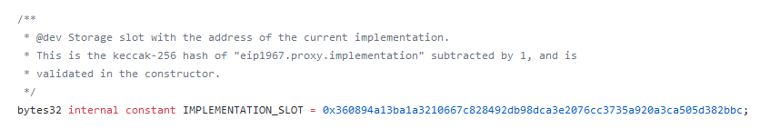
Dive into Proxy (Architect a Solidity Program)
https://github.com/OpenZeppelin/openzeppelin-sdk/tree/master/packages/lib/contracts/upgradeability
Keccak-256 - reserve a slot for proxy, so that this slot can never be allocated to compiler

Slide 14
Dive into Proxy (Architect a Solidity Program)
InitializableUpgradebilityProxy: with initializer & Initialize the impl address
BaseAdminUpgradeabilityProxy: Add admin, no Initializer
UpgradeabilityProxy: with constructor and set the impl slot (Code Explain)

Slide 15
Dive into Proxy (Architect a Solidity Program)
InitializableAdminUpgradebilityProxy: Initialize the impl and set admin address
AdminUpgradeabilityProxy: with constructor and set admin add
(Code Explain)

Slide 16
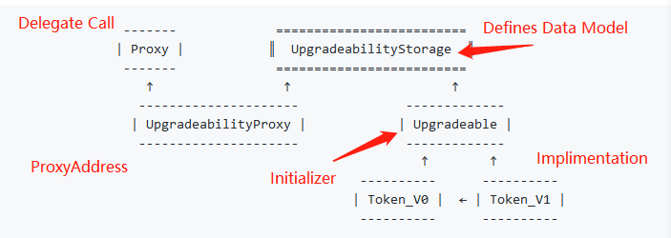
Dive into Proxy (Architect a Solidity Program)
Inherited, Unstructured, External Storage, ProxyFactory and ProxyAdmin
(Code Explain)
Inherited
What does it mean by upgradability? there is a initializer in the smartcontract or there are no constructor / initializer

Slide 17
Dive into Proxy (Architect a Solidity Program)
Drawbacks:
Data Model cannot be changed, can only be updated or add new features
(Code Explain)

Slide 18
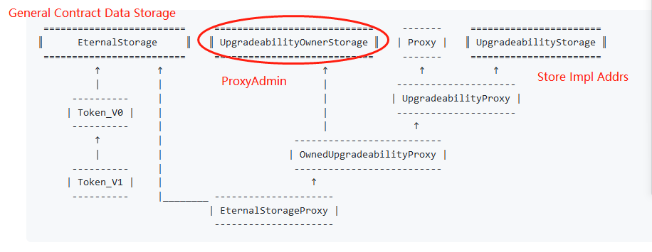
Dive into Proxy (Architect a Solidity Program)
Eternal Storage
(Code Explain)

Slide 19
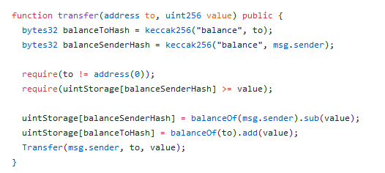
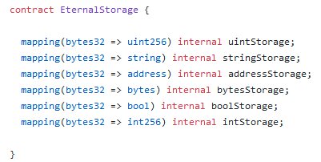
Dive into Proxy (Architect a Solidity Program)
Eternal Storage

Slide 20
Dive into Proxy (Architect a Solidity Program)
Pros:
The actural impl contract's data structure doesn't need to follow the previous impl contract's data structure
Cons:
Hard to write, as we need to extract all the data storing out

Slide 21
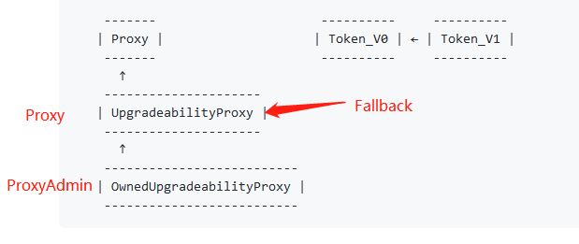
Dive into Proxy (Architect a Solidity Program)
Unstructured
(Code Explain)

Slide 22
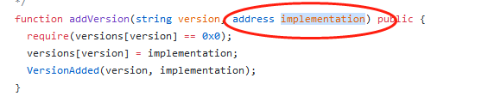

Dive into Proxy (Architect a Solidity Program)
Unstructured
Use pregenerated impl address
Use fixed impl Use pregenerated address
address

Slide 23
Dive into Proxy (Architect a Solidity Program)
ProxyAdmin & ProxyFactory (Code Explain)
Check if IniupgradProxy and AdminUpgradeProx have initializer (Inherited with admin)
Unstructured Storage has contrustor, so can use upgradeto without init data

Slide 24
Factory and Proxy Pattern
What Is the Factory Pattern?
The idea of the factory pattern is to have a contract (the factory) that will carry the mission of creating other contracts.
Why Use the Factory Pattern in Solidity?
1 If you want to create multiple instances of the same contract and you’re looking for a way to keep track of them and make their management easier.
2 Save gas on deployment: You can deploy only the factory and use it later to deploy the other contracts.
3 Improve contract security: make logic simpler, upgradeable, so safer.

Slide 25
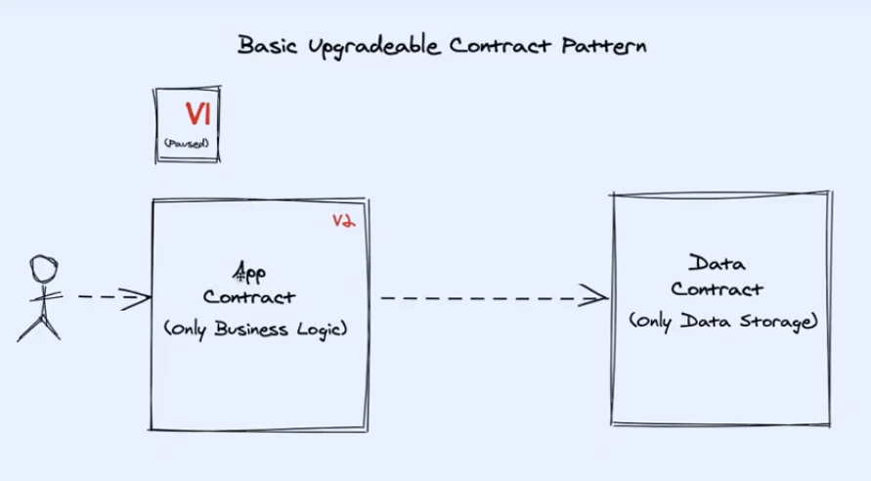
Factory and Proxy Pattern

Slide 26
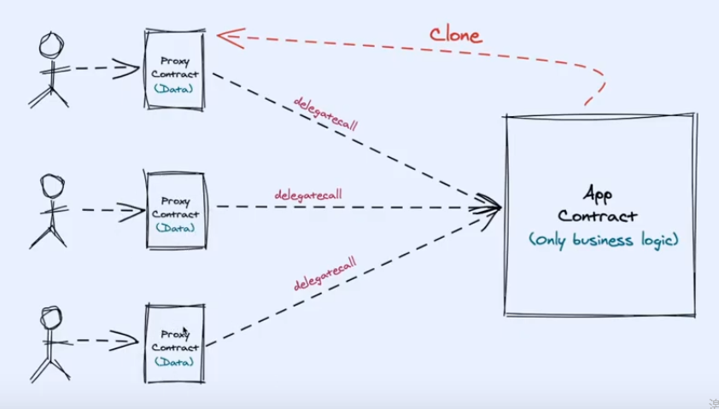
Factory and Proxy Pattern

Slide 27
Factory and Proxy Pattern: Openzeppelin
What Is the Factory Pattern?
The idea of the factory pattern is to have a contract (the factory) that will carry the mission of creating other contracts.
Why Use the Factory Pattern in Solidity?
1 If you want to create multiple instances of the same contract and you’re looking for a way to keep track of them and make their management easier.
2 Save gas on deployment: You can deploy only the factory and use it later to deploy the other contracts.
3 Improve contract security: make logic simpler, upgradeable, so safer.

Slide 28
Contract Quick Learning Tricks
1. read test cases
2. read contract deploy scripts

Slide 29
Code Demo
Tasks:
1. Add Proxy admin and Proxy Factor to PrivateStamp
2. Explain Aave's contract
3. Add version to make Proxy upgradeable

Slide 30
Web3 Introduction
Components: https://web3js.readthedocs.io/en/v1.3.0/
eth - package allows you to interact with an Ethereum
blockchain and Ethereum smart contracts. query, sendTx etc.
subscribe - function lets you subscribe to specific
events in the blockchain. Example: Dex trading
contract - makes it easy to interact with smart contracts
on the ethereum blockchain
account - contains functions to generate Ethereum
accounts and sign transactions and data.
personal - package allows you to interact with the
Ethereum node’s accounts

Slide 31
Gas vs GasLimit vs GasPrice
Gas vs GasPrice vs Gas Limit
Gas is the unit of calculation that indicates the fee for a particular action or transaction.
Excuting every line of code requires gas = fule
The Gas Limit is the maximum amount of Gas that a user is willing to pay for performing this action or confirming a transaction (a minimum of 21,000).
Max Gas
The price of Gas (Gas Price) is the amount of Gwei that the user is willing to spend on each unit of Gas.
Auction = willingness to pay

Slide 32
Estimate Gas
Generate Encode Data
Get Estimated Gas

Slide 33
Transaction Type
Query vs Write
Call - query, no gas
Write to Contrcts
Step 1: Generate Encode Data

Slide 34
Transaction Type
Query vs Write （Code Demo)
Write to Contrcts
Step 2: Sign a transaction
Step3: Send Raw Transaction
replace 0x with signedTransaction.rawTransaction

Slide 35
Function Call RPC vs signedTx
RPC （Code Demo)
Send Raw Post request

Slide 36
Code Demo
Add Web3 to React (Code Demo)

